Slide 1

Data Science DIABETES PREDICTION
By
Kanak Budhlani (110)
Chirag Bansod (125)

Slide 2
Contents
Introduction
Methodology
Result & Discussion
Conclusion
Data Analysis

Slide 3

Introduction
This is our Data Science Graphical Data Analysis with R project on data science DIABETES PREDICTION conataning 8 Different Attributes.
In this we will analysis this data to do some exploratory data analysis along with data visualization to have a better understanding of the dataset to do future predictions if possible.
Graphs are useful for non-numerical data, such as colours, flavours, brand names, and more. When numerical measures are difficult or impossible to compute, graphs play an important role.
Various types of plots drawn in R programming are :
Plots with Single Variables
Plots with Two Variables
Plots with Multiple variables.
Special Plots

Slide 4


Methodology
In this salary dataset , the different methods used to draw the graphs are :
Firstly we need to install two packages using the command ,
Install packages(“tidyverse”)
Install packages(“ggplot2”)
Install packages(“farver”)
2. The next step is to import the dataset used , for this first we need to save the dataset file with .csv extension , then we need to import the data in our R studio file by clicking on the environment and then click on import dataset and import our excel file .
3. Now as the data has been imported , we’ll read the data by using read.csv() function
Ex- data1 <- read.csv(“path and name of dataset”)
4. For getting the summary of our dataset we use function summary(dataset _ name)
5. As specified in the dataset , we can take different values of x and y as the column names of our dataset for comparison and to get the inference from it.

Slide 5
Methodology
Now we will begin with our coding part , first we need to read the library i.e library(ggplot2),to draw a graph the following code is used: ggplot(diabetes, aes(x=__)) + ggtitle("__") +
geom_histogram(aes(y = 100*(..count..)/sum(..count..)), binwidth = 1, colour="__", fill="__") + ylab("__")
7. Here the graph name can be any graph which we want to use according to our need for the dataset.
8. Graphs like geom _ bar , geom _ point , for piechart we use pie ad for histogram we use hist.
9. Using the same code mentioned above we can draw different graphs by changing the value of x and y and specifying the graph required.
10. Lastly by observing and studying the graph we will get our required output and inference for our dataset.

Slide 6
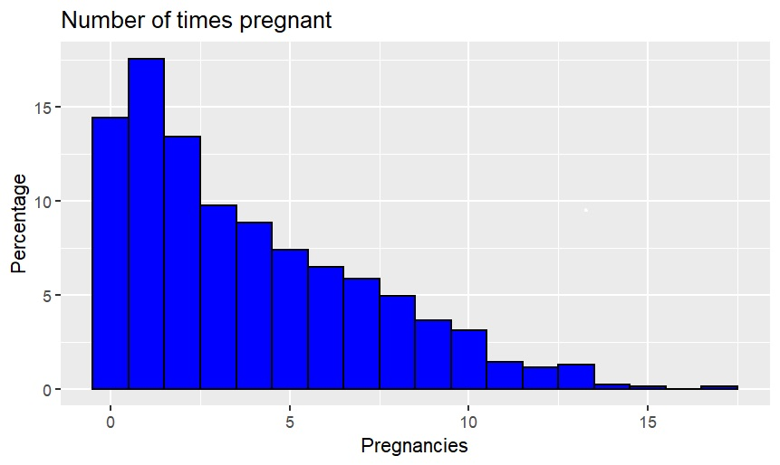
Plotting Histograms of Numeric Values
1) Pregnancies

Slide 7
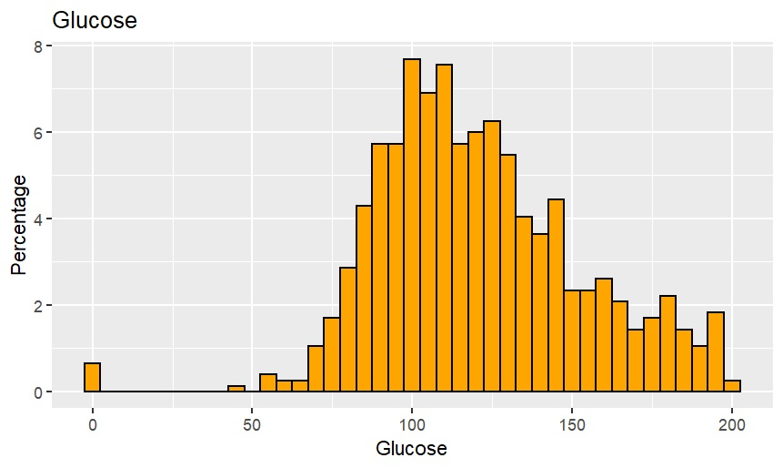
Plotting Histograms of Numeric Values
2) Glucose

Slide 8
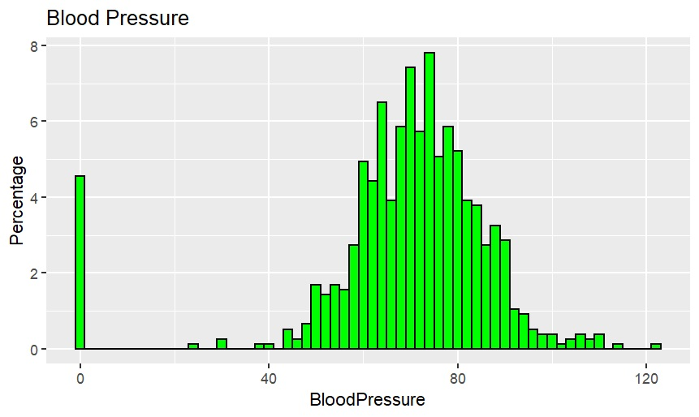
Plotting Histograms of Numeric Values
3) Blood pressure

Slide 9
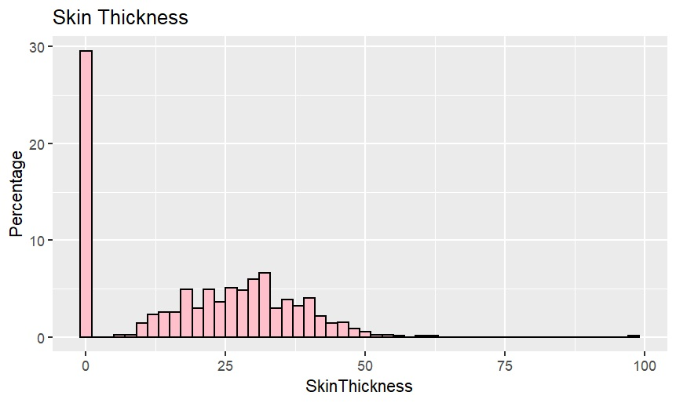
Plotting Histograms of Numeric Values
4) Skin Thickness

Slide 10
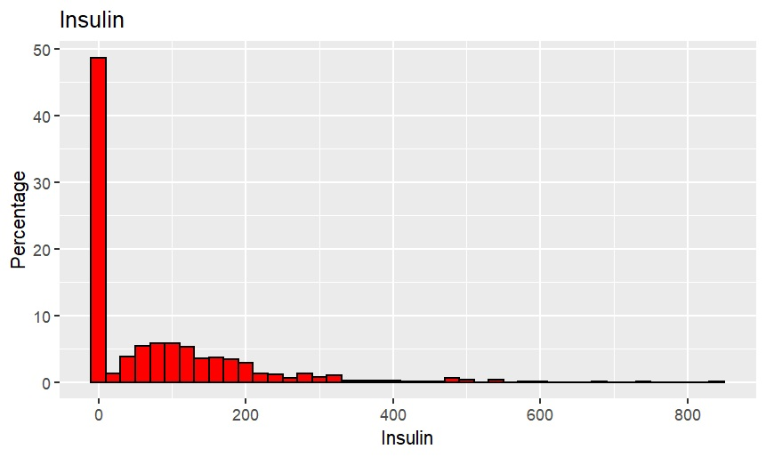
Plotting Histograms of Numeric Values
5) Insulin

Slide 11
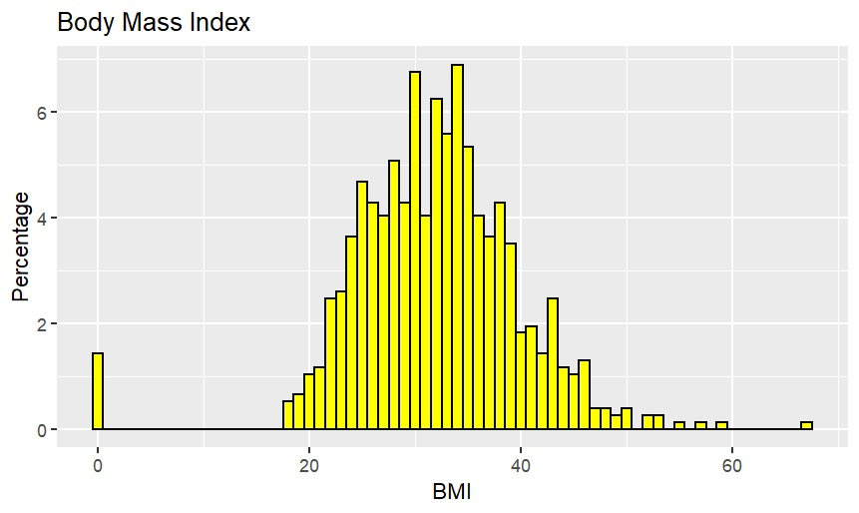
Plotting Histograms of Numeric Values
6) BMI

Slide 12
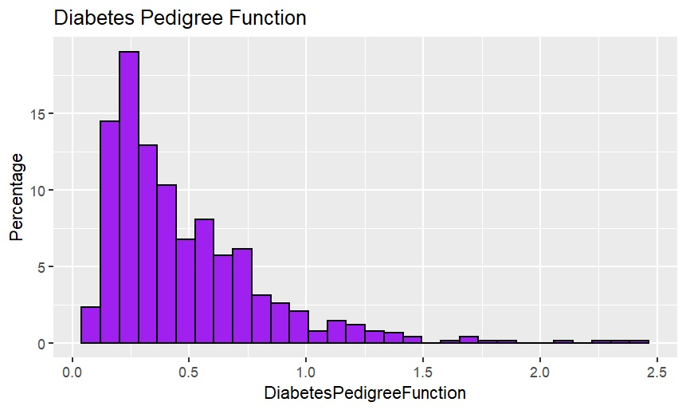
Plotting Histograms of Numeric Values
7) Diabetes Pedigree Function

Slide 13
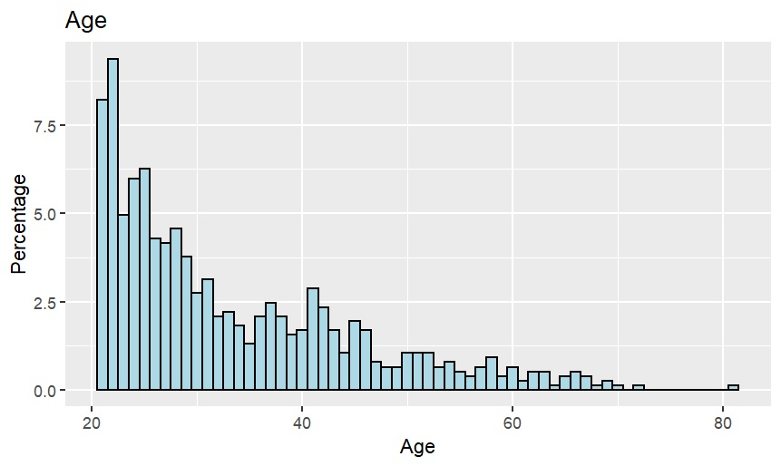
Plotting Histograms of Numeric Values
8) Age

Slide 14

Conclusion
After analyzing the data of Diabetes Prediction with the help of r programming, we have learned how to analyze data in the form of visual representation like graph.

Slide 15




Thank you
kanakbudhlani44@gmail.com
chiragb7901@gmail.com

